Slide 1

INSTITUTE :UIE
DEPARTMENT: ALL ACADEMIC UNITS
Bachelor of Engineering (All Sections)
Subject Name and Code:
Engineering Physics 23SPH-141
Prepared by: Ms. Arminder
UNIT 3
QUANTUM MECHANICS
DISCOVER . LEARN . EMPOWER

Slide 2
COURSE OBJECTIVES
The course is designed to make the students industry ready to contribute in the growing demand of the industry at local, national and international level.
It will make the students competent to understand basic concepts and applications of advanced engineering physics and apply its principles in their respective fields at global platform.
It will enhance the skill level of the students and shall make them preferred choice for getting employment in industry and research labs.
It will give thorough knowledge of the discipline to enable students to disseminate knowledge in pursuing excellence in academic areas.

Slide 3

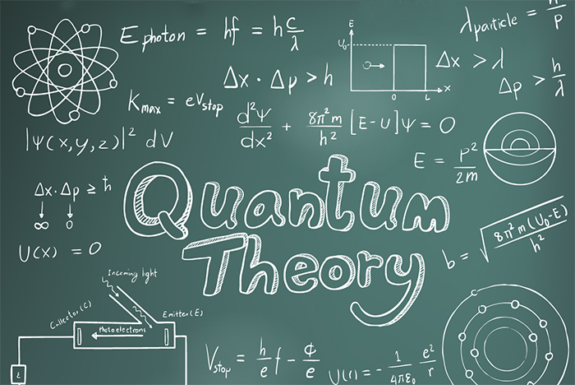
COURSE OUTCOME
CO Number | Title On completion of this course, the students are expected to learn | Level
CO1 | Quote the basic fundamental concepts of lasers, optical fibres, crystallography, ultrasonic oscillations, semiconductor physics, quantum mechanics and nanotechnology. | Remember, Understand
CO2 | Demonstrate the working of various lasers, fibre components, semiconductor devices; explain the behaviour of crystalline solids, quantum and nano-scale systems. | Understand
CO3 | Solve problems by applying principles related to lasers, fibres, semiconductors, oscillations, quantum and nanoscience. | Applying
CO4 | Compare various lasers and fibres, semiconducting devices, crystalline materials, structures at quantum and nanoscale on the basis of their properties for industrial applications. | Analyze
CO5 | Develop various systems using lasers, fibres, semiconductors and nanomaterials for futuristic applications. | Design
Figure 1 Quantum Theory [1]

Slide 4
LECTURE OBJECTIVE
1
Students will learn about uncertainty principle.
2
Students will learn about different relations uncertainty principle.
3
In this lecture students will learn about applications of uncertainty principle. .

Slide 5
QUANTUM MECHANICS
Figure 4.1 Quantum Theory [1]

Slide 6
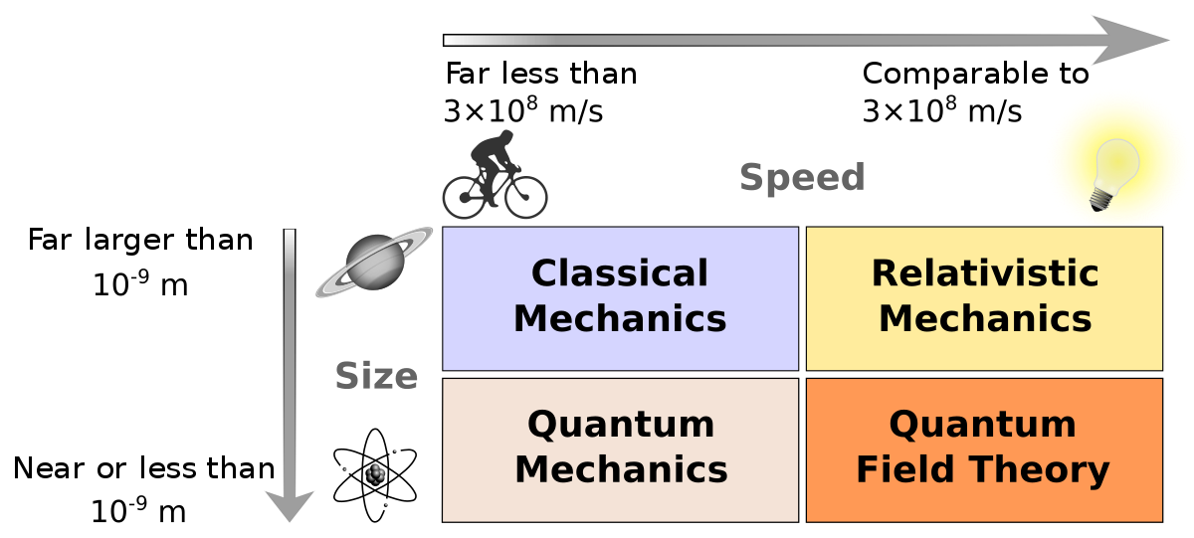
NEED OF QUANTUM MECHANICS
Problems remained from classical mechanics that relativity didn’t explain
Attempts to apply the laws of classical physics to explain the behavior of matter on the atomic scale were consistently unsuccessful.
Figure 4.2 Need of Quantum Theory [2]

Slide 7
NEED OF QUANTUM MECHANICS
Problems included:
Blackbody radiation
The electromagnetic radiation emitted by a
heated object
Photoelectric effect
Emission of electrons by an illuminated metal
Figure 3.2 Need of Quantum Theory [2]

Slide 8
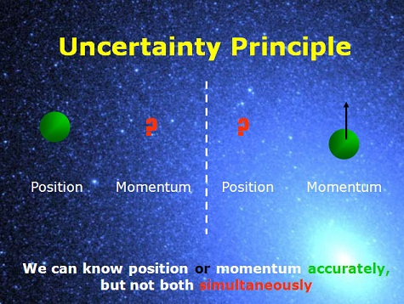
HEISENBERG UNCERTAINTY PRINCIPLE
It states that it is impossible to measure spontaneously and simultaneously both the values of members of pair which determine the behavior of atomic system
Figure 4.3 Uncertainty Principle [3]

Slide 9
HEISENBERG UNCERTAINTY PRINCIPLE
In 1927 Heisenberg proposed “the uncertainty principle”. This principle is a result of the dual nature of matter.
In quantum mechanics a particle is described by a wave packet, which represents and symbolizes all about particle and moves with group velocity. According to Born’s probability interpretation “the particle may be found anywhere within the wave packet”.
This implies that the position of the particle is uncertain within the limits of wave packet. Moreover, the wave packet has velocity spread and hence there is uncertainty about the velocity or momentum of the particle. This means it is impossible to know where the particle is and what is its exact velocity and momentum

Slide 10
HEISENBERG UNCERTAINTY PRINCIPLE
Statement of uncertainty principle: “The product of uncertainties in determining the position and momentum of the particle at the same time instant is at best of the order of ”
Where, ∆x is uncertainty in determining position of the particle and ∆p is that in determining the momentum.
This relation is universal and holds for all the canonically conjugate quantities like position and momentum, energy and time, angular momentum and angle, etc. whose product has a dimension of action (joule. Sec)

Slide 11
HEISENBERG UNCERTAINTY PRINCIPLE

Slide 12
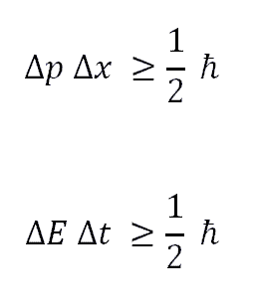
HEISENBERG UNCERTAINTY RELATIONS
The product of uncertainties in the measurement of physical variables must be at least equal to Planck's constant
Figure 4.4 Uncertainty Relation [4]

Slide 13
APPLICATION OF UNCERTAINITY PRINCIPLE:
Nonexistence of electron in the nucleus

Slide 14
APPLICATION OF UNCERTAINITY PRINCIPLE:
Nonexistence of electron in the nucleus

Slide 15
SUMMARY
Both position and momentum of particle can’t measure simultaneously.
Heisenberg uncertainty principle directly gives that electrons can’t exist inside nucleus.
Heisenberg uncertainty principle relates energy and time as canonical conjugate variable.

Slide 16
FAQ
Write three different forms of Heisenberg uncertainty principle.
Prove that electrons can’t exist inside nucleus.
Define Heisenberg uncertainty principle.

Slide 17
REFERENCES
[1] https://stradallc.com/2016/02/12/design-like-quantum-physics/
[2] https://en.wikipedia.org/wiki/Branches_of_physics
[3] https://www.zmescience.com/science/physics/particle-momentum-position-measurement-54354
[4] https://english2biotech.wordpress.com/2013/01/28

Slide 18
REFERENCES
Video link
https://nptel.ac.in/courses/122/106/122106034/
https://www.youtube.com/watch?v=a8FTr2qMutA
Books
Concepts of Modern Physics, (Fifth Edition) A Beiser, McGraw Hill International.
Fundamentals of Physics, David Halliday, Robert Resnick and Jearl Walker, Wileyplus

Slide 19
THANK YOU
arminder.uis@cumail.in

